Slide 2
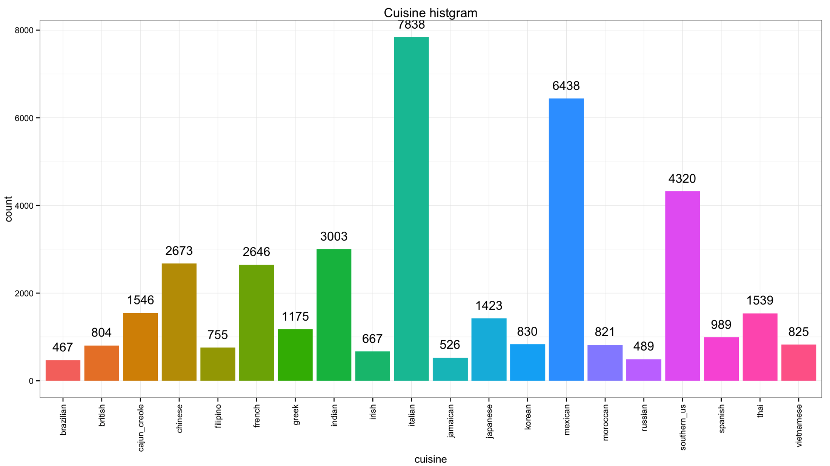
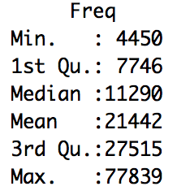
Introduction
Data representation
Cuisine(top 3):
Italian
Mexican
Southern_us

Slide 3
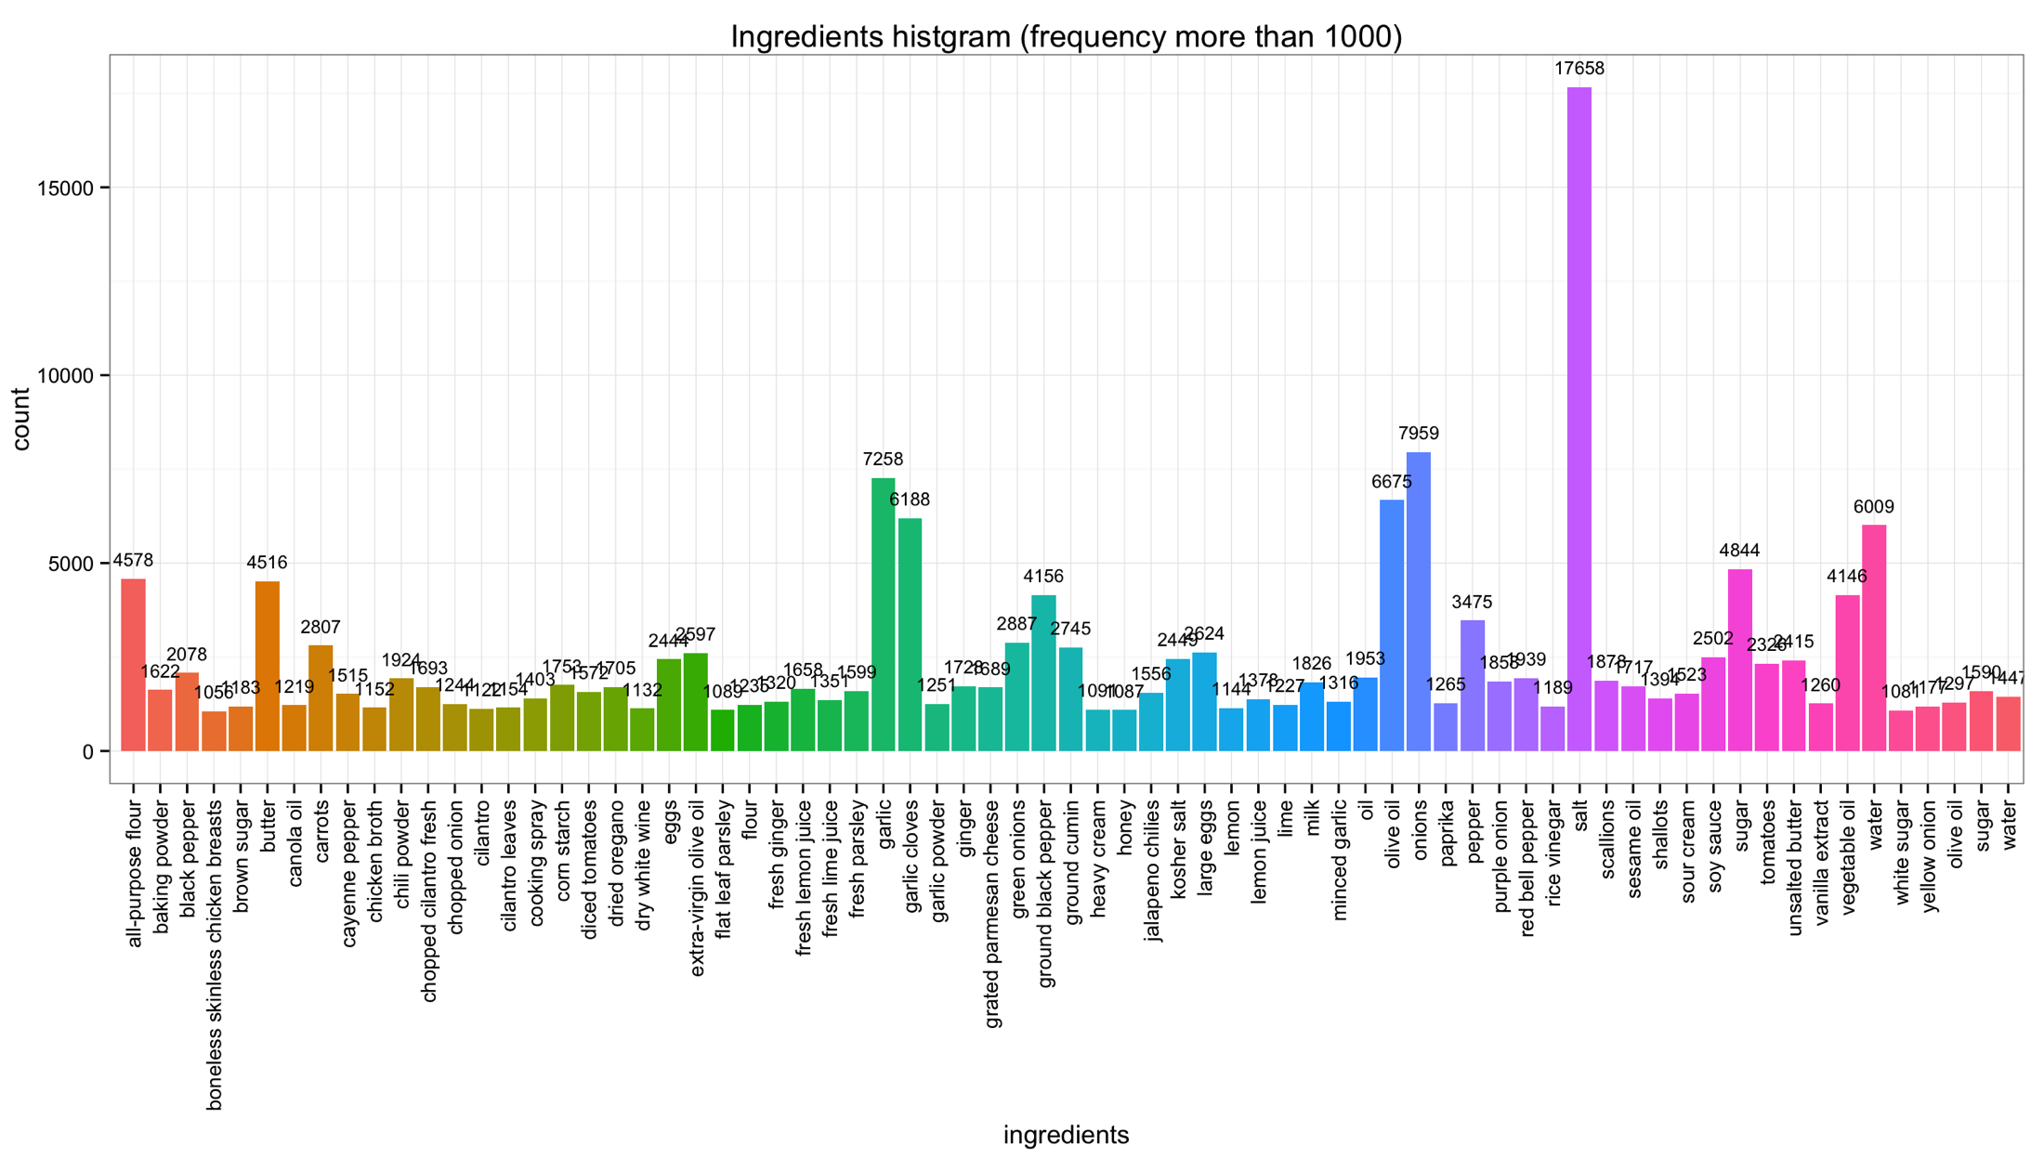
Introduction
Data representation
Ingredients of all cuisine
Italian
Mexican
Southern_us

Slide 4
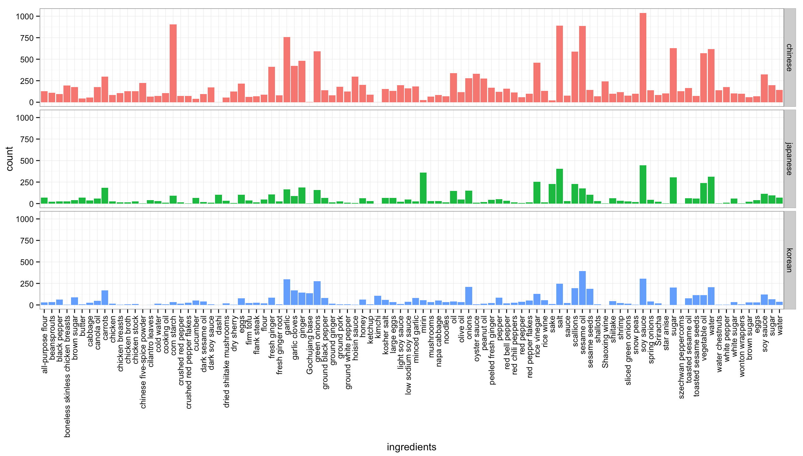
Introduction
Data representation
Ingredients of different cuisines(Chinese, Korean, and Japanese)

Slide 5
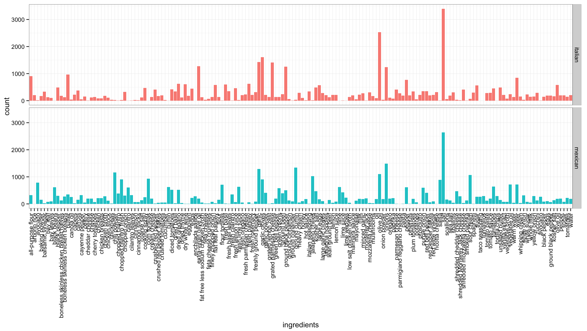
Introduction
Data representation
Ingredients of different cuisines(Italian and Mexican)

Slide 6
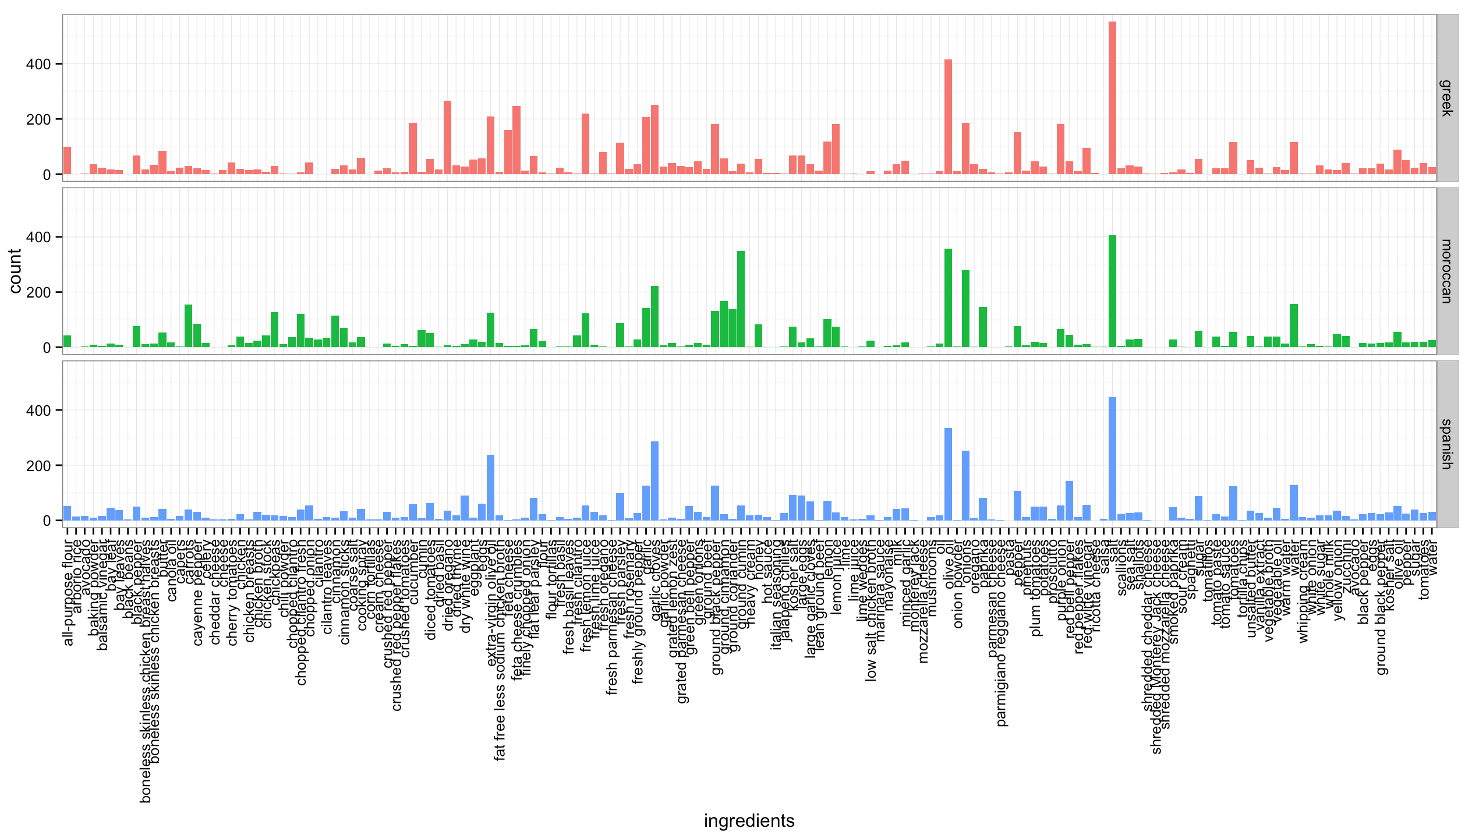
Introduction
Data representation
Ingredients of different cuisines( Greek, Moroccan, and Spanish)

Slide 7
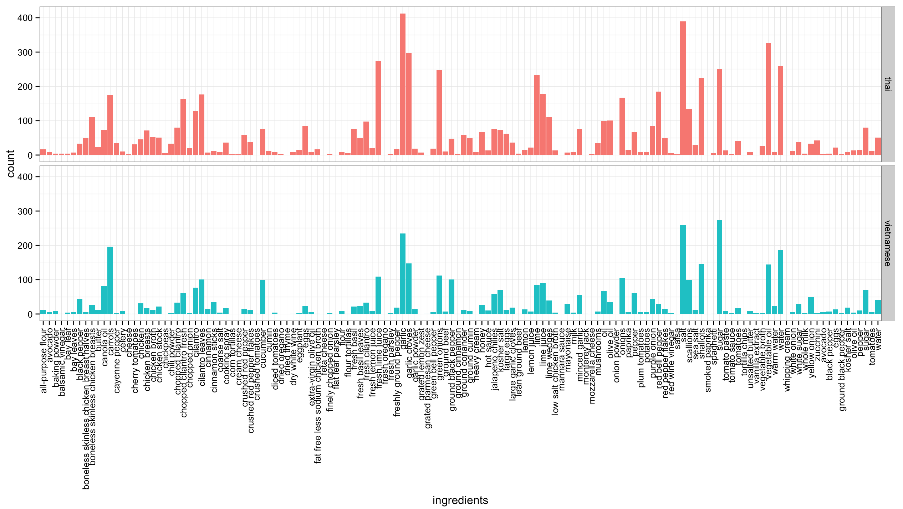
Introduction
Data representation
Ingredients of different cuisines(Thai and Vietnamese)

Slide 8
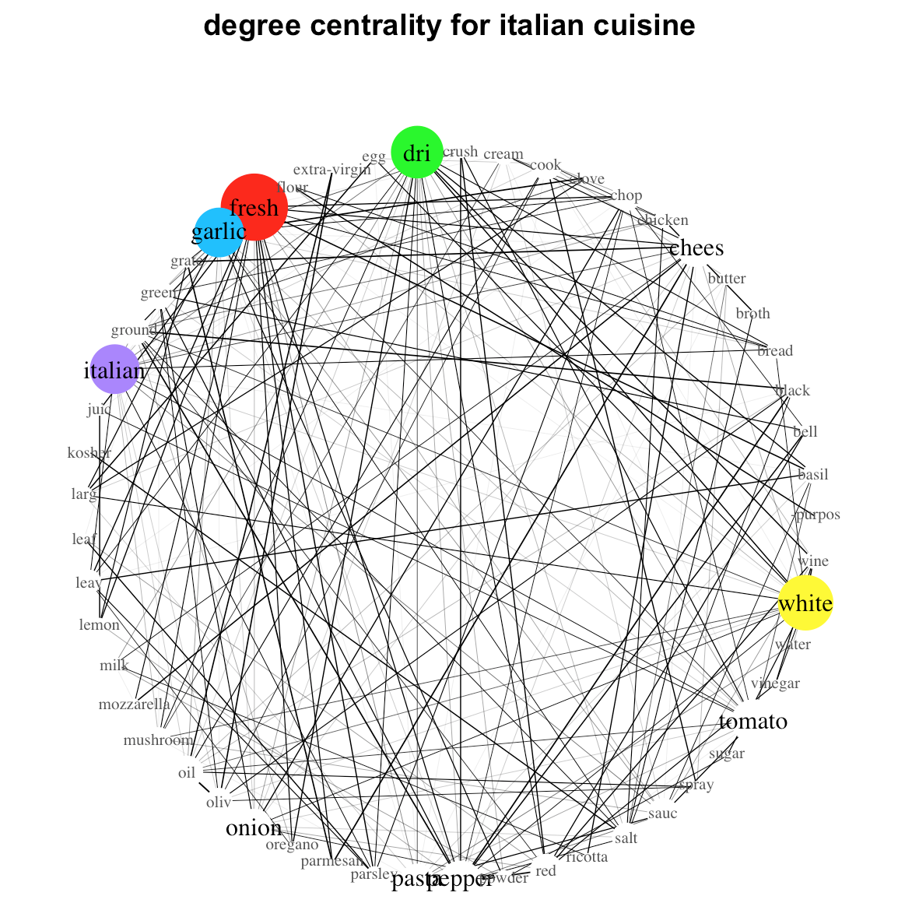
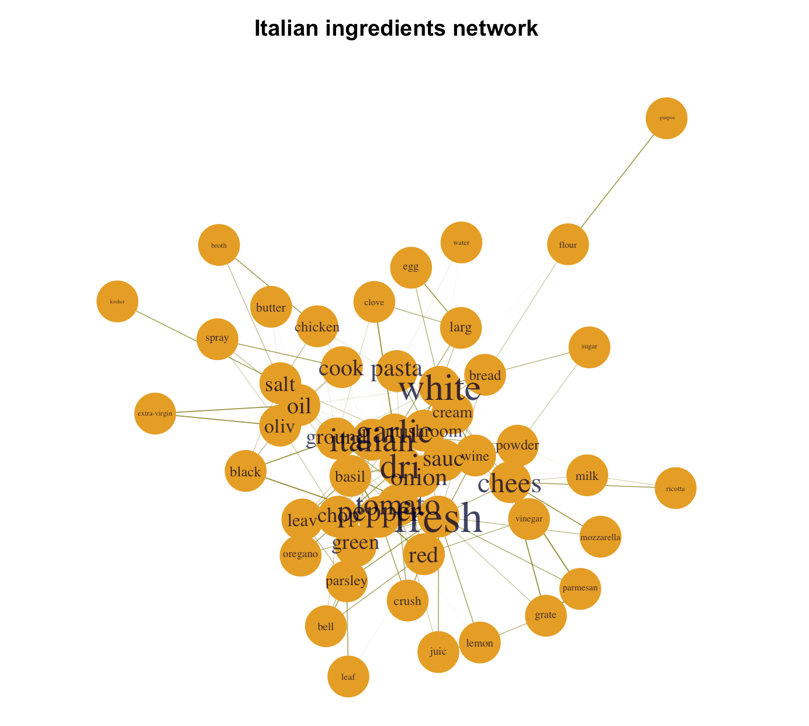
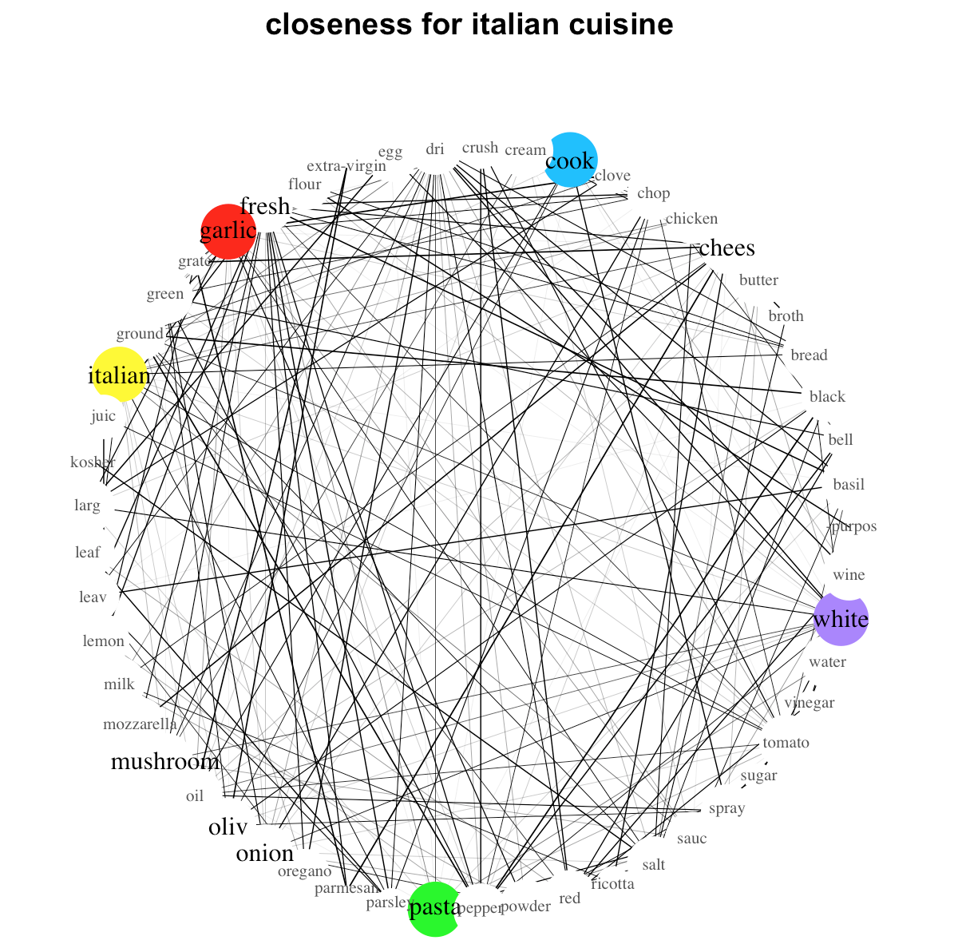
Introduction
Data representation
Focus on Italian cuisine to show its ingredient network
After removing stop-words, numbers and stemming

Slide 9
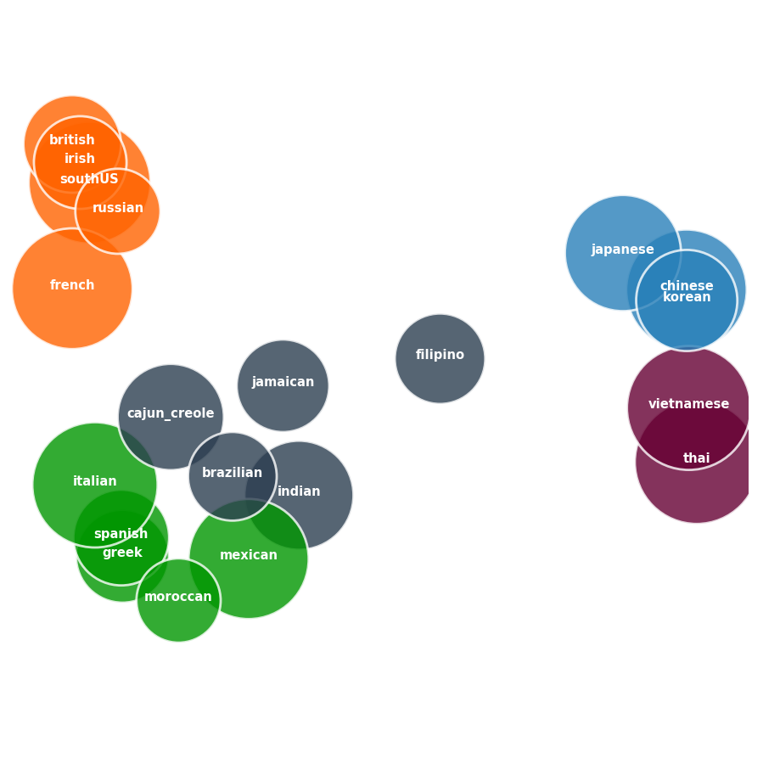
K-means Cluster
Using Clusters to visualize training dataset
Tf-idf : each term in gradients and cuisine as documents
PCA: reduced to 2-Dimensentions
K-means cluster: k = 5
Size of bubbles: Jaccard Similarity(one v.s the other cuisines in its cluster)

Slide 10
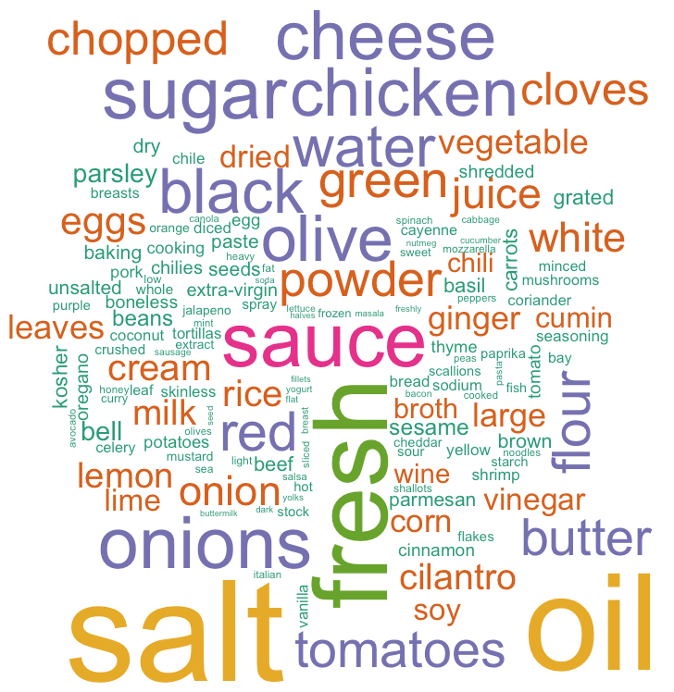
Word Cloud
Ingredients frequency more than 1000

